Slide 1


Green Pace
Security Policy Presentation
Developer: Bradley Byard

Slide 2

OVERVIEW: DEFENSE IN DEPTH
This Security Policy was needed to address security threats in C++ and implement ways to mitigate hacks and security problems.
This policy focuses on Defense in Depth which is a secure design principle that aims to increase security through diversity (Intrigano, 2016). The idea is not to rely on a single defense or even a single kind of defense, that way if one defense is overcome there is still another one to get past which can mitigate damage from an attack or prevent it all together (Intrigano, 2016).

Slide 3
THREATS MATRIX
In the policy the security threats are listed for categories: severity, likelihood, remediation cost, priority, and level. These are shown on page 26 of the policy
Likely String Correctness, Exceptions | Priority Preventing SQL injection Memory Protection
Low priority Exceptions Closing Files Properly | Unlikely Secure/Valid Data Types Proper Data Values

Slide 4
10 PRINCIPLES
1. Validate Input – Don’t trust user input STD-003-C++, STD-004-C++, STD-008-C++
2. Heed Compiler Warnings – Don’t ignore warnings STD-001-C++, STD-010-C++
3. Architect/Design for Sec. Policy – Consider each feature STD-002-C++ STD-005-C++
4. Keep it Simple – Avoid complication
5. Default Deny – If you don’t allow it, deny it STD-007-C++
6. Principle of least Privilege – Only privileges for needed tasks
7. Sanitize Data – sanitize data STD-004-C++
8. Defense in Depth – multiple security layers
9. Quality Assurance –eliminate vulnerabilities STD-006-C++, STD-007-C++
10. Coding Standard – Develop a standard STD-009-C++
NOTE: The Security Standard from the policy that best fits the principle is shown on the right side of that principle

Slide 5
CODING STANDARDS
STD-001-C++ C++ Secure and Valid Data Type Standard
STD-002-C++ C++ Proper Data Values
STD-003-C++ C++ String Correctness
STD-004-C++ C++ Preventing SQL Injection
STD-005-C++ C++ Memory Protection
STD-006-C++ C++ Assertions
STD-007-C++ C++ Exceptions
STD-008-C++ C++ validating user Input
STD-009-C++ C++ Closing Files Properly
STD-010-C++ C++ Valid Iterator Range
RED – High Priority
YELLOW -- Medium Priority
GREEN – Low Priority

Slide 6
ENCRYPTION POLICIES
Encryption At Rest
Encrypting data at rest can protect the organization from unauthorized access to data when computer hardware is sent for repair or discarded.
Encryption At Flight
The process of encrypting data while the data is being transmitted. In some applications data may be unencrypted while it is at rest on drive arrays, but encrypted while it is being transmitted to provide protection.
Encryption in Use
Protecting data at rest is far easier than protecting data in motion -- information that is being transported between systems. Encryption plays a major role in protecting data in use or in motion.

Slide 7
TRIPLE-A POLICIES
Authentication
Successful authentication occurs when one’s credentials are entered into a system resource and compared against stored user information with a database, which ultimately allows a user to gain access, or be denied
Authorization
With Authorization we usually use a username and password type setup, or some other type of commonly used method of "authentication" to actually authenticate to that very system resource
Accounting
the concept of "accounting" (i.e., effectively auditing and monitoring this type of environment) includes removing aged and dormant accounts, validating access rights for privileged accounts, reviewing log reports for access rights violations, and other essential activities
Resource: (Flank, n.d.)

Slide 8
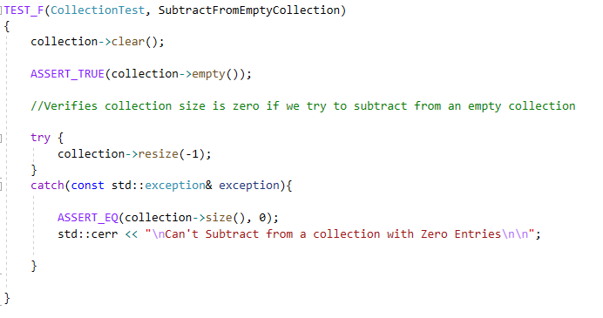
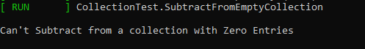
Unit Testing
Unit testing is a huge part of getting ahead of the game in security. The Google test Framework is a great way to apply unit testing
Below is an example of an Out of range Exception unit Test. I Used try catch exception handling here. Used at to define a collection range that was too high, then catch it as an out of range error, and display that info to the screen.
We can see below this unit Test output passed with a green Run and error message

Slide 9

AUTOMATION SUMMARY

Slide 10
TOOLS
DevSecOps evolved from DevOps as development teams began to realize that the DevOps model didn’t adequately address security concerns. Instead of retrofitting security into the build, DevSecOps emerged as a way to integrate the management of security earlier on throughout the development process (Maerz, 2021). Through this method, application security begins at the outset of the build process, instead of at the end of the development pipeline. With this new approach, an engineer of DevSecOps strives to ensure that apps are secure against cyberattacks before being delivered to the user, and are continuously secure during app updates (Maerz, 2021).
Automation tools are a great way to test your code and make them secure! Tools like CodeSonar and Clang can be integrated into your code to check certain security parameters!

Slide 11
RISKS AND BENEFITS
ACT NOW or WAIT? Which sounds better. I have always preferred acting now but if we wait in terms of software security, we might get hacked and lose or leak personal data. If we act now, and develop secure software from the start, and plan to maintain we are much less likely to lose data and get hacked. We don’t want to sit around and wait for that to happen!

Slide 12
RECOMMENDATIONS
This security policy is an overview. It lists 10 coding standards. Programming languages are huge, and there should be much more standards then 10 so I recommended looking around at some additional resources also and other coding standards for the language you are working with.
Additional Resources:
CERT C coding standard
https://wiki.sei.cmu.edu/confluence/display/cplusplus/Relation+to+the+CERT+C+Coding+Standard

Slide 13
CONCLUSIONS
Work hard to be secure long before an application is released, and to follow coding standards that will keep your code high quality and secure! Your customers will thank you for it!

Slide 14
REFERENCES
Intrigano, YouTube. (2016). Software security - Design Category Defense in Depth, Monitoring Traceability. YouTube. https://www.youtube.com/watch?v=vaEXHX2IFHg
Flank. (n.d.). Why Information Security Policies and Procedures are Important. Flank. https://flank.org/faqs/what-is-aaa.
Maerz, C. (2021, July 7). What's the difference between devops and devsecops? AppDynamics. https://www.appdynamics.com/blog/product/devops-vs-devsecops/.

